Slide 1
MLA0403 – Deep Learning
Deep Learning Based – Reinforcement Learning Adaptive Cybersecurity Defense System using MTCNN in Deep Learning
Guided By:
Dr.A.M.Arul Raj
Professor
Institute of SIMATS
SIMATS Engineering
Student Name:
M SaiRam – 192425291
Y Narasimha Reddy – 192425281
V Sunil Kumar – 192425292
Institute of SIMATS
SIMATS Engineering

Slide 2
Abstract
Develops an intelligent cybersecurity defense system using deep learning.
Uses reinforcement learning to adapt to evolving cyber threats.
Employs MTCNN for efficient feature extraction and pattern detection.
Continuously learns from network activities and attack behaviors.
Detects cyberattacks with improved accuracy and speed.

Slide 3
Aim and Objective
Aim
To develop an AI-based adaptive cybersecurity defense system.
To detect and prevent cyber threats in real time.
To use reinforcement learning for continuous system improvement.
To enhance network security using deep learning and MTCNN.
Objectives
Detect cyberattacks with high accuracy.
Learn and adapt to new threats automatically.
Reduce false positives and false negatives.
Improve real-time response and overall network security.

Slide 4
Introduction
Cybersecurity is essential to protect digital systems from increasing cyber threats.
Traditional security methods are often ineffective against new and evolving attacks.
Deep learning enables intelligent detection of complex attack patterns.
Reinforcement learning helps the system learn and adapt from previous experiences.
MTCNN is used for efficient feature extraction and improved threat identification.
This project aims to provide an adaptive, accurate, and real-time cybersecurity defense system.

Slide 5
Literature Review
S.No | Year | Author | Title | Methodology | Algorithm | Key Findings
1 | 2024 | Merzouk et al. | DRL-Based Intrusion Detection | DRL-IDS | Deep RL | Adaptive Detection
2 | 2024 | Yang et al. | DRL Network Intrusion Detection | DRL-NIDS | DQN, Actor-Critic | Unknown Attack Detection
3 | 2025 | Xu et al. | Deep Learning-Based IDS | Deep Learning | CNN, RNN, LSTM | Improved Attack Detection
4 | 2025 | Landolt et al. | Multi-Agent RL in Cybersecurity | MARL Defense | Multi-Agent RL | Adaptive Cyber Defense
5 | 2026 | Odeh | RL-Based IoT Intrusion Detection | Autonomous RL | Reinforcement Learning | Real-Time Adaptive Defense

Slide 6
Problem Statement
Traditional cybersecurity systems cannot effectively detect evolving cyber threats.
High false alarm rates reduce the efficiency of security monitoring.
Static defense mechanisms fail to adapt to new attack patterns.
There is a need for an intelligent, real-time, adaptive cybersecurity defense system using deep learning and reinforcement learning.

Slide 7
Existing System
Uses traditional and fixed security rules.
Detects mainly known attack patterns.
Has difficulty adapting to new threats.
May produce false alarms during monitoring.
Requires frequent manual updates for changing attacks

Slide 8
Proposed System
Uses deep learning for intelligent threat detection.
Uses reinforcement learning for continuous adaptation.
MTCNN is used for feature extraction and pattern detection.
Learns from new attack behaviors and network activities.
Dynamically improves security response and reduces false alarms.

Slide 9
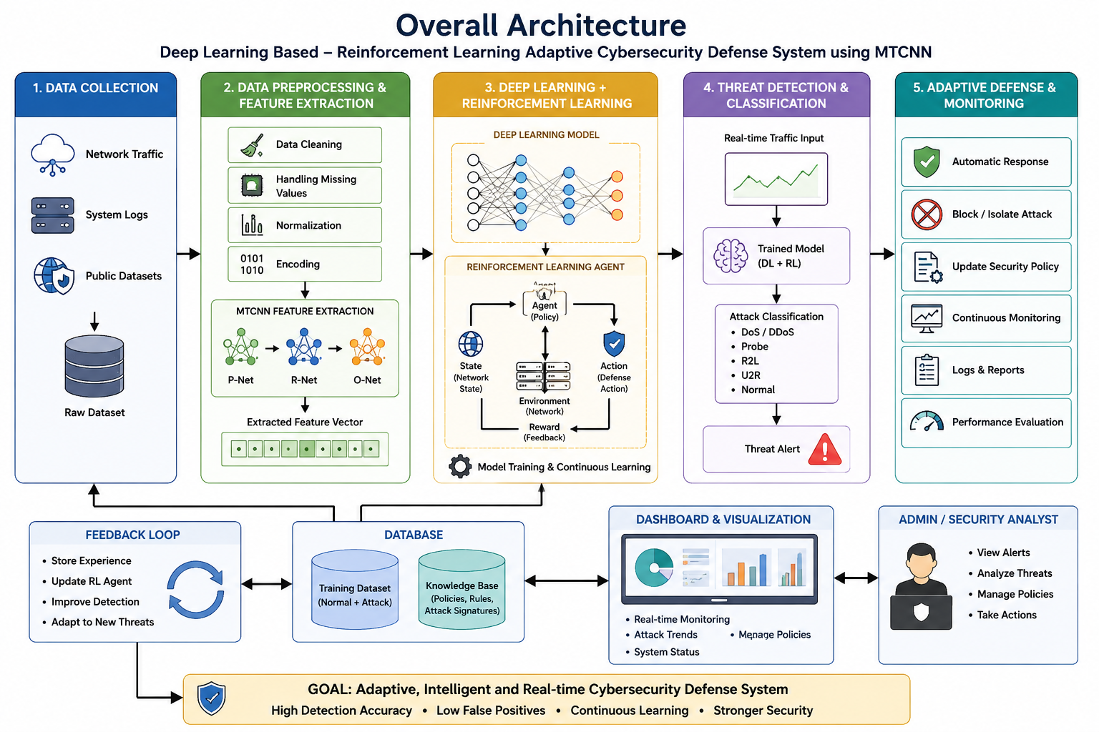

Slide 10
SDG Goals (Sustainable Development Goals)
SDG 9 – Industry, Innovation and Infrastructure
Promotes advanced AI-based cybersecurity technologies.
Strengthens secure digital infrastructure.
SDG 16 – Peace, Justice and Strong Institutions
Protects digital systems from cyber threats.
Improves trust, privacy, and data security.
SDG 17 – Partnerships for the Goals
Encourages collaboration in cybersecurity research.
Supports knowledge sharing and innovation in AI security.

Slide 11
Design & Module Planning
Module 2: Data Preprocessing & Feature Extraction
Module 3: Deep Learning & Reinforcement Learning
Module 1: Data Collection
Collect network traffic and security log data.
Gather normal and malicious activity datasets.
Store data for training and testing.
Validate dataset quality.
Remove missing and duplicate data.
Normalize and clean the dataset.
Use MTCNN for feature extraction.
Prepare data for model training.
Train the deep learning model.
Implement reinforcement learning agent.
Learn attack patterns continuously.
Update security policies dynamically.

Slide 12
Module 1: Data Collection
Collect network traffic and security logs containing normal and malicious activities.
Store and organize the collected data for training and testing.
Identify and label different attack patterns and network activities.
Check the completeness, reliability, and quality of the collected dataset.
Prepare a validated dataset for preprocessing and feature extraction.

Slide 13
Module 2: Data Preprocessing & Feature Extraction
Remove missing, duplicate, and irrelevant data from the dataset.
Clean and normalize the collected cybersecurity data.
Extract important features from network and attack activities.
Use MTCNN for feature extraction and pattern detection.
Prepare the extracted features as suitable input for model training.

Slide 14
Module 3: Deep Learning & Reinforcement Learning
Train the deep learning model using the prepared cybersecurity data.
Implement a reinforcement learning agent for adaptive security.
Enable the system to learn normal and malicious attack patterns continuously.
Use learning experiences to adapt to new and evolving cyber threats.
Dynamically update security policies to improve detection and response.

Slide 15
Conclusion
Developed an intelligent cybersecurity defense system using deep learning and reinforcement learning.
MTCNN improves feature extraction for accurate threat detection.
The system adapts to new and evolving cyberattacks automatically.
Provides real-time detection, faster response, and improved network security.
Reduces false alarms and enhances overall cybersecurity performance.
Offers a scalable and reliable solution for modern cyber defense.

Slide 16
References
Yang et al. (2024) – Reviews deep reinforcement learning techniques for network intrusion detection and adaptive cyber threat identification.
Merzouk et al. (2024) – Studies security and adversarial robustness in deep reinforcement learning-based intrusion detection systems.
Xu et al. (2025) – Examines deep learning-based intrusion detection, including data processing, attack detection, and cybersecurity datasets.
Kanimozhi & Ramesh (2025) – Proposes a deep reinforcement learning approach for intrusion detection and attack mitigation in software-defined networks.
Landolt et al. (2025) – Reviews multi-agent reinforcement learning approaches for adaptive and automated cyber defense.
Yang et al. (2026) – Provides an updated study of deep reinforcement learning for network intrusion detection and identifies current research challenges.

Slide 17


